Slide 4
Who am I?I
Why am I here?
What Should I do?I

Slide 6
Isaiah 9:6
6 For to us a child is born, to us a son is given, and the government will be on his shoulders. And he will be called Wonderful Counselor, Mighty God, Everlasting Father, Prince of Peace.

Slide 8
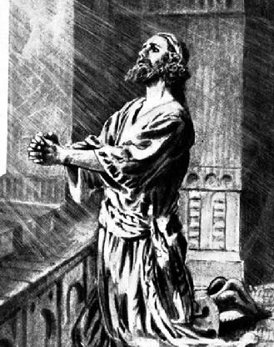

Slide 9
Jesus is our Wonderful Counselor

Slide 11
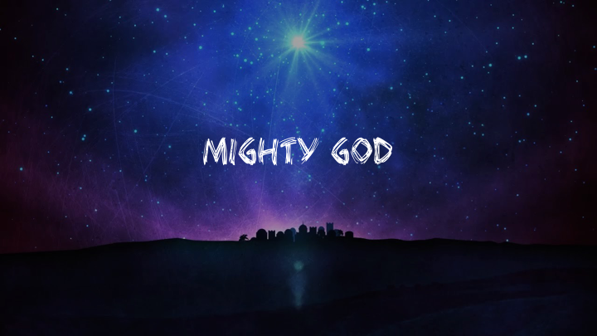

Slide 13
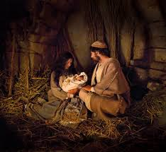
“⁶ For to us a child is born, to us a son is given; and the government shall be upon his shoulder, and his name shall be called Wonderful Counselor, Mighty God.”

Slide 18
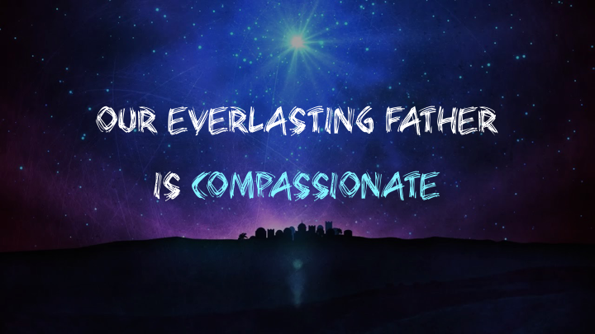

Slide 21
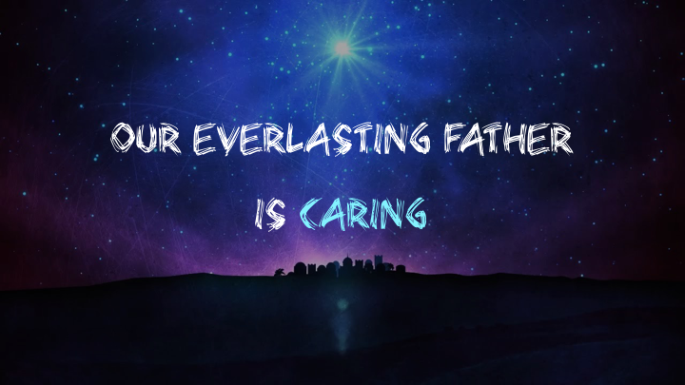

Slide 23
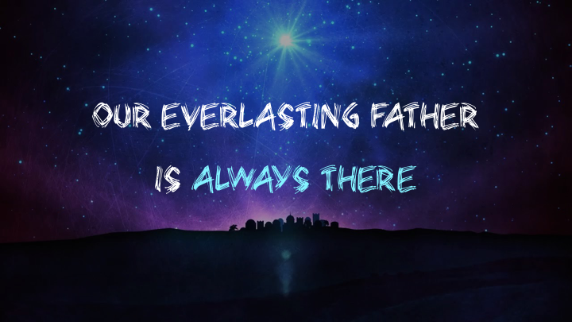

Slide 26
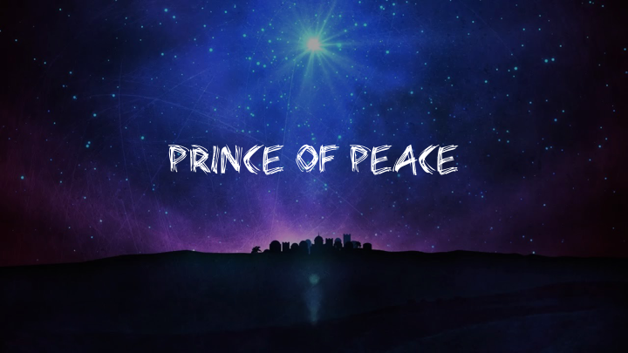

Slide 29
